Slide 1
Using the Skills Library Competency Checklist Workshop Outline and Practice Exercises
School Year 2023-2024
Jennifer Leonard
The Skills Library
Email: jleonard@skillslibrary.com
Phone: 781-321-7894
Web: https://skillslibrary.com

Slide 2
Before the workshop
Before the database workshop, sign into the database with the username and password you were given. If you are not sure of your password, use the “Retrieve Password” feature to have your password emailed to you. If you don’t have a username/password, you, or a mentor or co-worker, can email Jennifer Leonard at jleonard@skillslibrary.com to request an account. Please include your name, email, and name of your school and CVTE program.
On the navigation bar along the top of the screen, click on the Instructions / About / Resources tab and choose View Rubric. Read or print out the rubric, which explains the 1 to 4 scale.
Next, on the navigation bar along the top of the screen, click on the Lesson Planning and Framework Views tab and choose “Searchable – View Competencies.” Briefly browse this page, noticing that you can browse by strand, topic, or keyword. Enter a keyword that might appear in your curriculum such as “paint” or “font” or “temperature” and click to search for that word.
Next, return to the home page. Above the Exploratory calendar, click the button for “Dashboard Chart” to see if any skills/competencies have been assessed so far for the students currently in your program.
Throughout this presentation, there is a series of activities, which can be done before, during, or after the database workshop. Projects 1-5 are recommended for an introduction to the database (or a review and “what’s new”) and Projects 6-10 are recommended for a workshop for experienced database users.

Slide 3
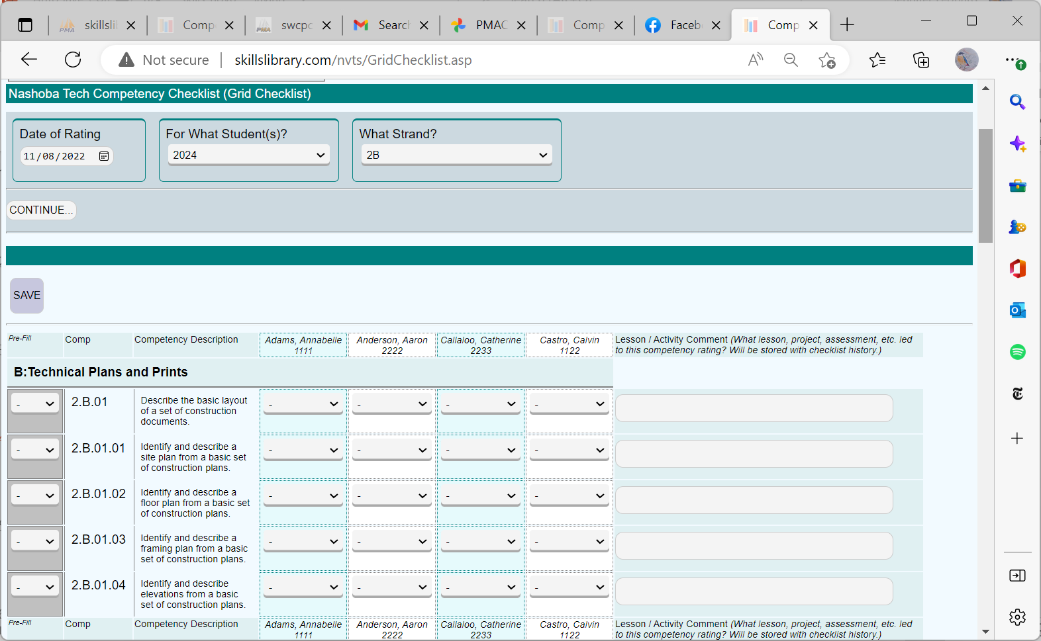
Competency Checklist Screen
The heart of the Skills Library Competency Checklist database is a simple checklist, based on the Massachusetts CVTE Frameworks.
The checklist is typically viewed as a grid, with a list of standards and competencies from the CVTE frameworks, and with a list of your students across the top.

Slide 4
Competency Checklist Screen
A 1-to-4 scale is used to evaluate student growth in these skills
4- Advanced, able to teach the skill, troubleshoot, and/or create exemplary products
3- Proficient- can perform the skill independently
2- Developing- still needs support
1- Introduced- The skill has been introduced and students have tried activities with this skill

Slide 5
Why track competencies ?
To identify and document what students know and are able to do
To better understand which students are on track with learning targets and which may need extra support
To share the competencies with students/families so they can take ownership of their learning

Slide 6
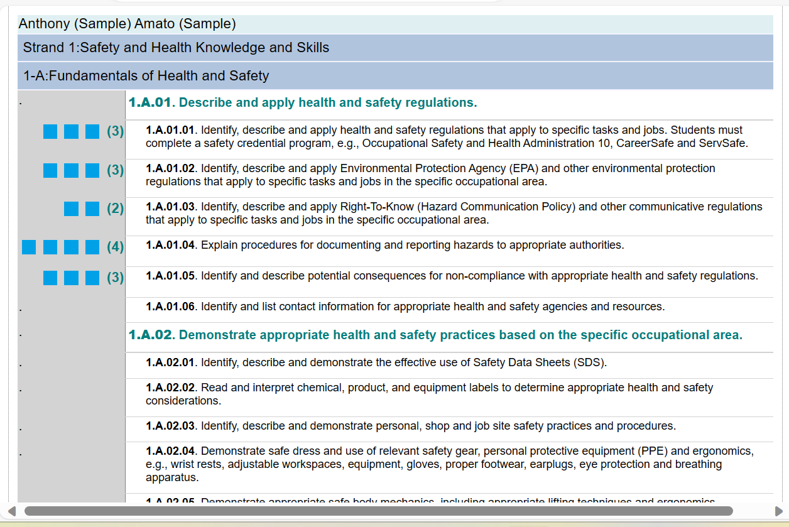
Competency Checklist Screen
The checklist can be viewed in a variety of different layouts:
- in a grid view,
- or by student,
- or by competency,
- or as a printer-friendly list designed for sharing with students.
There are a variety of summary reports available.

Slide 7
When to track and share competencies ?
Enter competencies into Skills Library for every grading period
You may also enter competencies when your students reach key milestones, such as completing a project or earning a credential.
Conduct student conferencing to discuss skills on track and those that need growth
Have students self-assess and create goals to improve in identified areas
Share competency reports with families during parent conferences

Slide 8
About the CVTE Frameworks
Strand 1: Health and Safety
Competency
2.E.04.02 -
Take necessary body measurements and perform calculations needed to create a sloper.
Standard
2.E.04 -Demonstrate Flat Pattern Design
Strand 2: Technical
Topic
2E - Apparel Design
CVTE Framework: Fashion Technology
Strand 4: Employability
Strand 5: Management and Entrepreneurship
Strand 6: Technology
Strand C: Certificates/Industry-Recognized Credentials

Slide 9
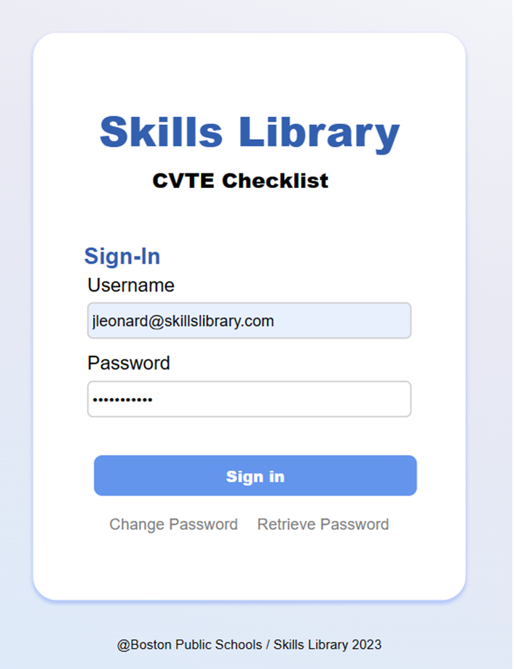
Sign-In Screen

Slide 10
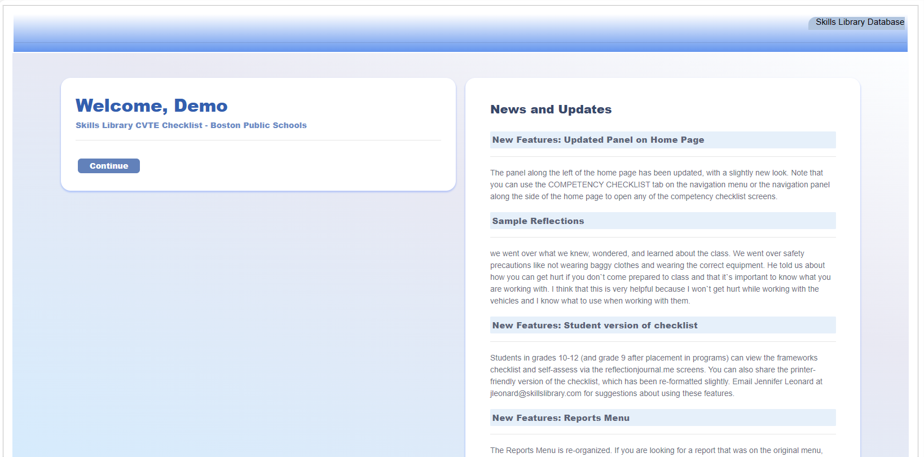
Welcome Page
Notice any updates on the welcome page and then click to continue….

Slide 11
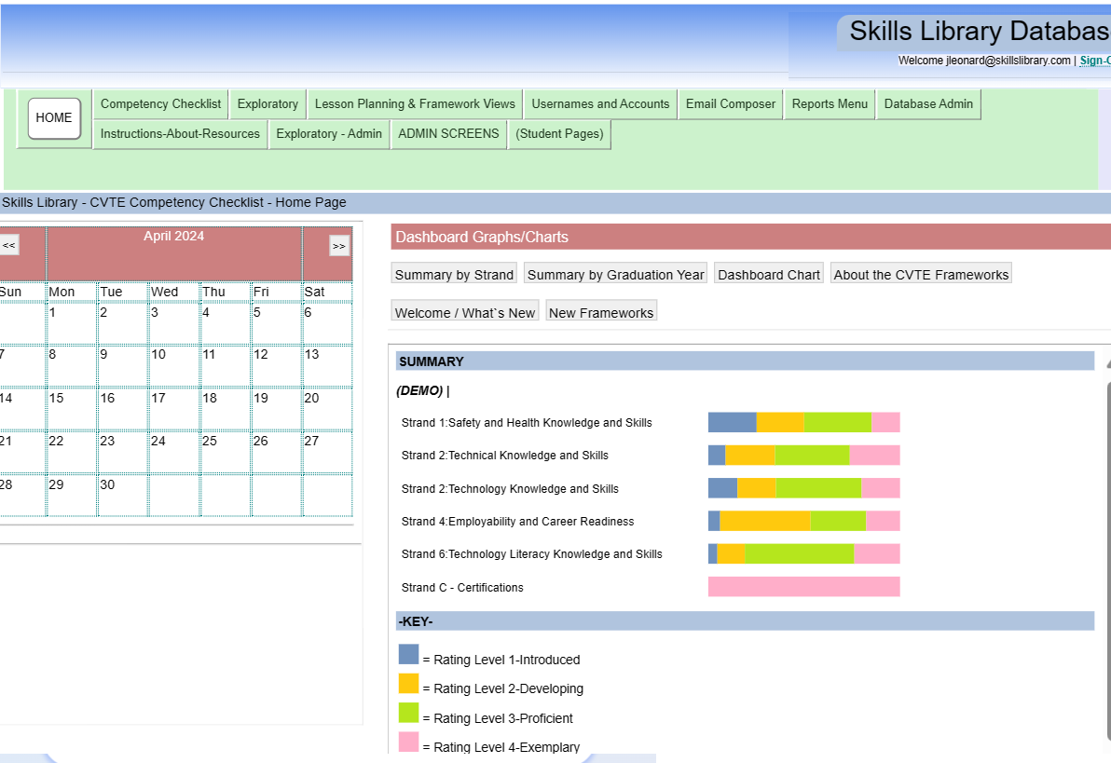
Home Page
Home page features:
Navigation bar along the top
Panel along the left of the screen with calendar or other options
Dashboard frame, with graphs/charts, links to slideshows, news/welcome messages, or other options.

Slide 12
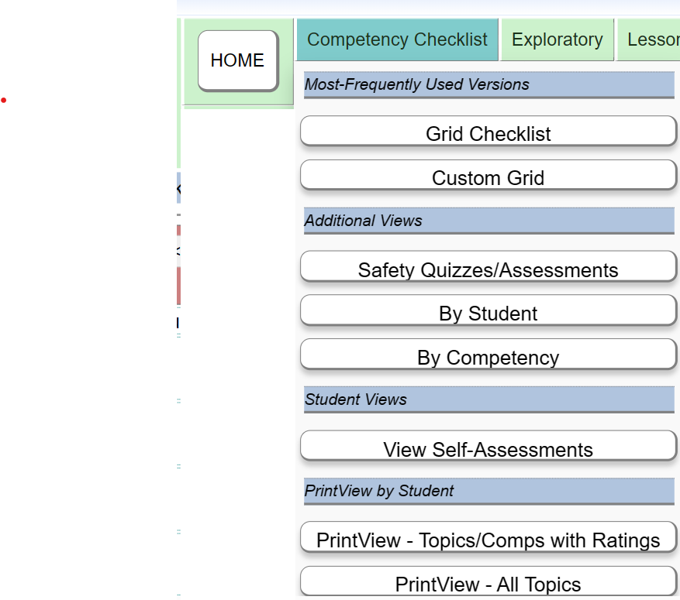
Navigate to the Competency Checklist
On the navigation menu along the top, choose Competency Checklist and then choose which version of the checklist you want to see.
Typically, choose the “Grid Checklist” which is the first option on the list.

Slide 13
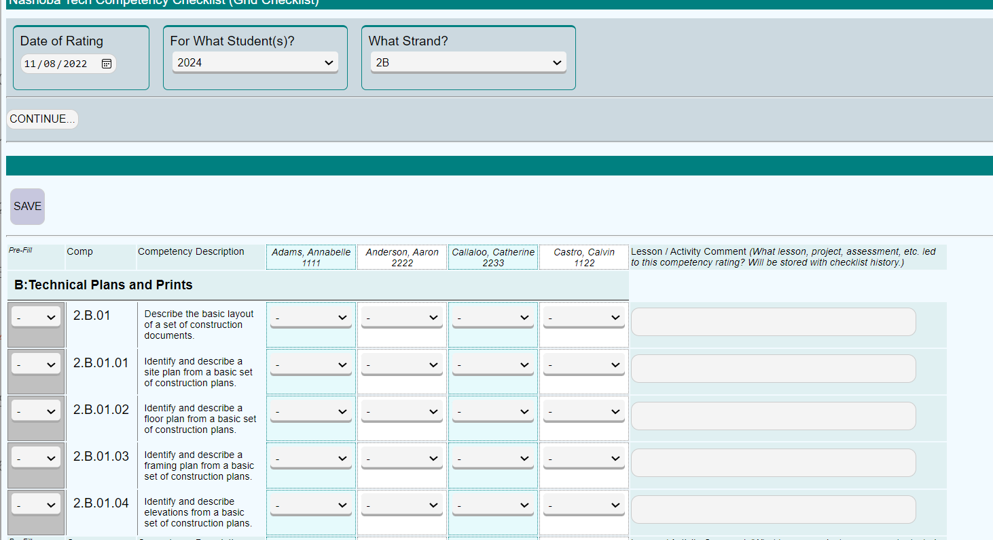
Competency Checklist Screen (Grid View)
Notice that most screens have a selection bar along the top, where you choose settings and then click to CONTINUE…
Selection criteria
Checklist... There are several different views:
Grid view
Custom Grid view
By competency
By student
By student, focus on safety skills
Printer-friendly, for student

Slide 14
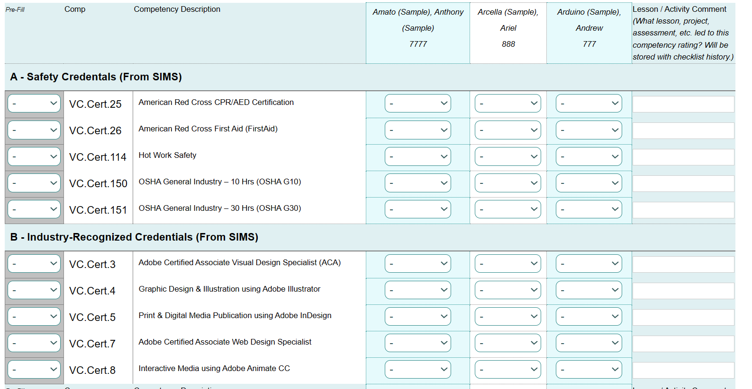
Industry-Related Certificates/Credentials
You can use the Grid Checklist, or the “By Competency” view, to enter information about industry-recognized credentials that your students have earned. Choose STRAND C, which lists credentials and other milestones. The list is drawn from the list provided by DESE, with a few local customizations. The list is organized with safety credentials first, then others from the DESE/SIMS list, and then other items, not from the DESE/SIMS list, such as other credentials, mini-courses completed, and other milestones. NOTE that the statewide SIMS reporting system requires that vocational programs submit the list of credentials earned, by students.

Slide 15
Project 1: Using the Grid Checklist and adding comments
[1.] From the navigation bar along the top of the screen, under the Competency Checklist tab, open the Grid Checklist. When the screen opens, choose Strand/Topic 2A, for your Grade 10 students.
[2.] Strand/Topic 2A focuses on safety skills specific to your program. Read over the list of skills,and find two or three that you have focused on with your Grade 10 or 11 students. Fill in ratings for these.
You can use the “Pre-Fill” column to fill in a typical rating, such as ‘2’ and then use the dropdown lists to change ratings for any students who are not yet at that level, or who are ahead of that level.
[3.] In the last column, add a brief comment explaining when you taught and/or assessed that skill. For example, you might write “Power Drill Safety Quiz” or “Safety Quiz: Handling Knives” or “Chemical Safety Lesson” in the comment field.
[4.] Click to SAVE.
[5.] Repeat for one other topic, such as 2B.
[6.] Repeat for Strand 4, noticing that there are some skills/competencies already assessed based on your Grade 10 students’ work last year in the Exploratory program.

Slide 16
Project 2: Using the “By Competency” screen
[1.] From the navigation bar along the top of the screen, under the Competency Checklist tab, open the “By Competency” screen. Choose one of the following general skills from Strand 5, (or any skill of your choice).
5.A.01.01 Define entrepreneurship and be able to recognize and describe the characteristics of an entrepreneur.
5.B.01.05 Identify and apply effective customer service skills and practices.
5.E.01.05 Explain the role of labor organizations.
5.E.01.06 Identify practices that support clean energy technologies and encourage environmental sustainability.
[2.] Choose your Grade 10 or 11 class,and click to continue.
[3.] Fill in ratings for your class and click to SAVE.
NOTE: You can use the “Pre-Fill” feature at the top of the screen and click to continue again. Pre-Fill will not lower any ratings that you have previously entered, but will fill in that rating for all students on the screen who have a blank or lower-than-the-pre-fill rating.
[4.] Repeat, for the same skill, for your other (Grade 10, 11, and 12) classes.

Slide 17
Project 3A: (optional) Tracking safety quizzes and assessments
[1.] From the navigation bar along the top of the screen, under the Competency Checklist tab, open the Safety Quizzes/Assessments screen. When the screen opens, choose an individual student name.
[2.] This page displays the skills/competencies in Strand 2A, focusing on safety skills. Read over the list, and provide a rating for this student, and a comment about what safety quizzes or assessments this student has passed. If there is more than one skill within an item, such as 2.A.01.03 “Uses Hand Tools and Power Tools Safely” you can save it multiple times, with different dates and comments, such as “Power Saw Safety Assessment” or “Power Drill Safety Assessment.”
[3.] If students have taken Safety Quizzes or Assessments not listed in Strand 2A, you can list these at the topic the page under S: Safety Quizzes/Assessments. You can list multiple items, on different dates and comments, under this heading.

Slide 18
Project 3B: (optional) Using the “By Student” screen
[1.] From the navigation bar along the top of the screen, under the Competency Checklist tab, open the “By Student” screen.
[2.] Choose Strand 6 and choose a specific student name. Fill in a rating for three or four competencies on this list, and add a comment about the projects or lessons when this competency was practiced or assessed.
[3.] Click to SAVE.

Slide 19
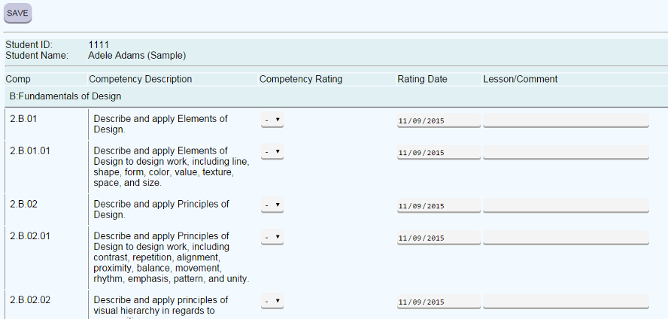
Student View & Self-Assessment
Students can sign into the student pages, using the shortcut address or the full address. See the home page to find these links.
Students can view the checklist and can self-assess using the self-assessment view of the checklist.
Self-assessment ratings and comments are stored in a separate column in the database, and can be viewed side-by-side alongside teacher ratings.

Slide 20
Project 4: Share the checklist with students via printout or PDF.
[1.] From the Competency Checklist tab, choose “Print/View- Topics/Comps with Ratings”.
[2.] When the screen opens, choose a student name in the students dropdown list, and choose “-ALL-“ under the “What Strand” dropdown list and click to continue. (When choosing a student name, choose one who has some ratings in the checklist.)
[3.] Save this screen to a PDF file. To print to PDF, you can press Ctrl-P on the keyboard to open a print dialog box. In the dialog box, choose to “Print to PDF” instead of printing to your printer. When prompted, give the file a name and click to “PRINT” and the file will be saved as a PDF.
→ SHARE THIS PDF AS WORKSHOP PRODUCT #1
[4.] From the Competency Checklist tab, choose “Print/View- All Topics.” When this screen opens, choose a student and choose “-ALL-“ to see this view, which lists all competencies whether or not there is a rating.

Slide 21
Project 5: Explore the new student pages to see how students can view the checklist.
[1.] From the navigation bar at the top of the screen, click the button for “STUDENT PAGES.” This opens the link https://skillslibrary.com/comp/studentpages (shortcut reflectionjournal.me) which is the same address that we use for Freshman Exploratory screens. The shortcut reflectionjournal.me will also bring you to this screen.
[2.] On this signin page, you may enter one of your own students, using the student’s ID and first name, or open for a sample student using Student ID 7777 and name Sample. (If choosing a student name, choose one who has some ratings in the checklist.)
[3.] When the menu opens, choose “View #1: Framework Checklist” and look at that screen.
[4.] On the navigation bar along the top of the screen, choose each of the views: View #1, View #2 and View Self-Assessment Plus.
[5.] On the navigation bar along the top of the screen, choose “Self-Assess with Framework Checklist.” When this screen opens, choose a topic, such as 2B and click to Continue. Look at the screen and think about whether your students could self-assess using this screen.
[6.] Next, under the “(OR) Choose a Project/Unit” choose “Career Research Project” and click to continue. Look at the screen and think about whether your students could self-assess using this screen after completing a career research project.
→ Print any of these screens to PDF and share as Workshop Product #2

Slide 22
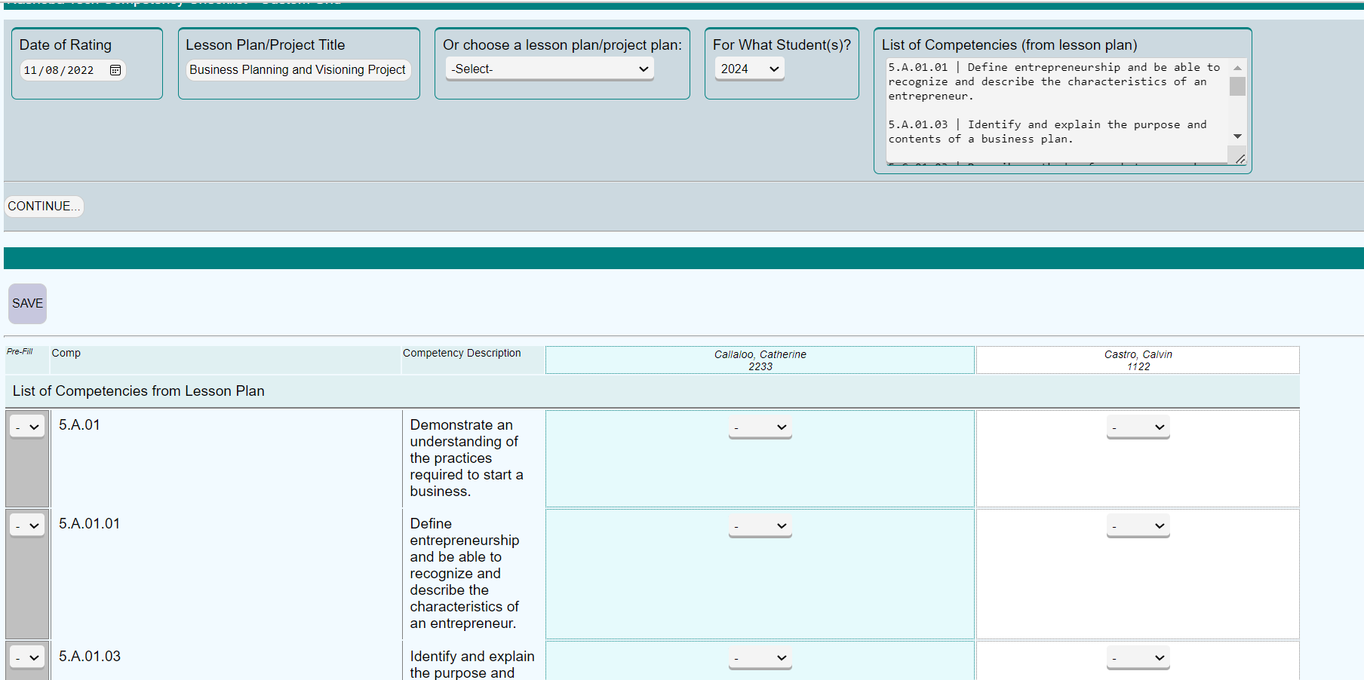
Use the Custom Grid to track competencies linked to a particular lesson plan.

Slide 23
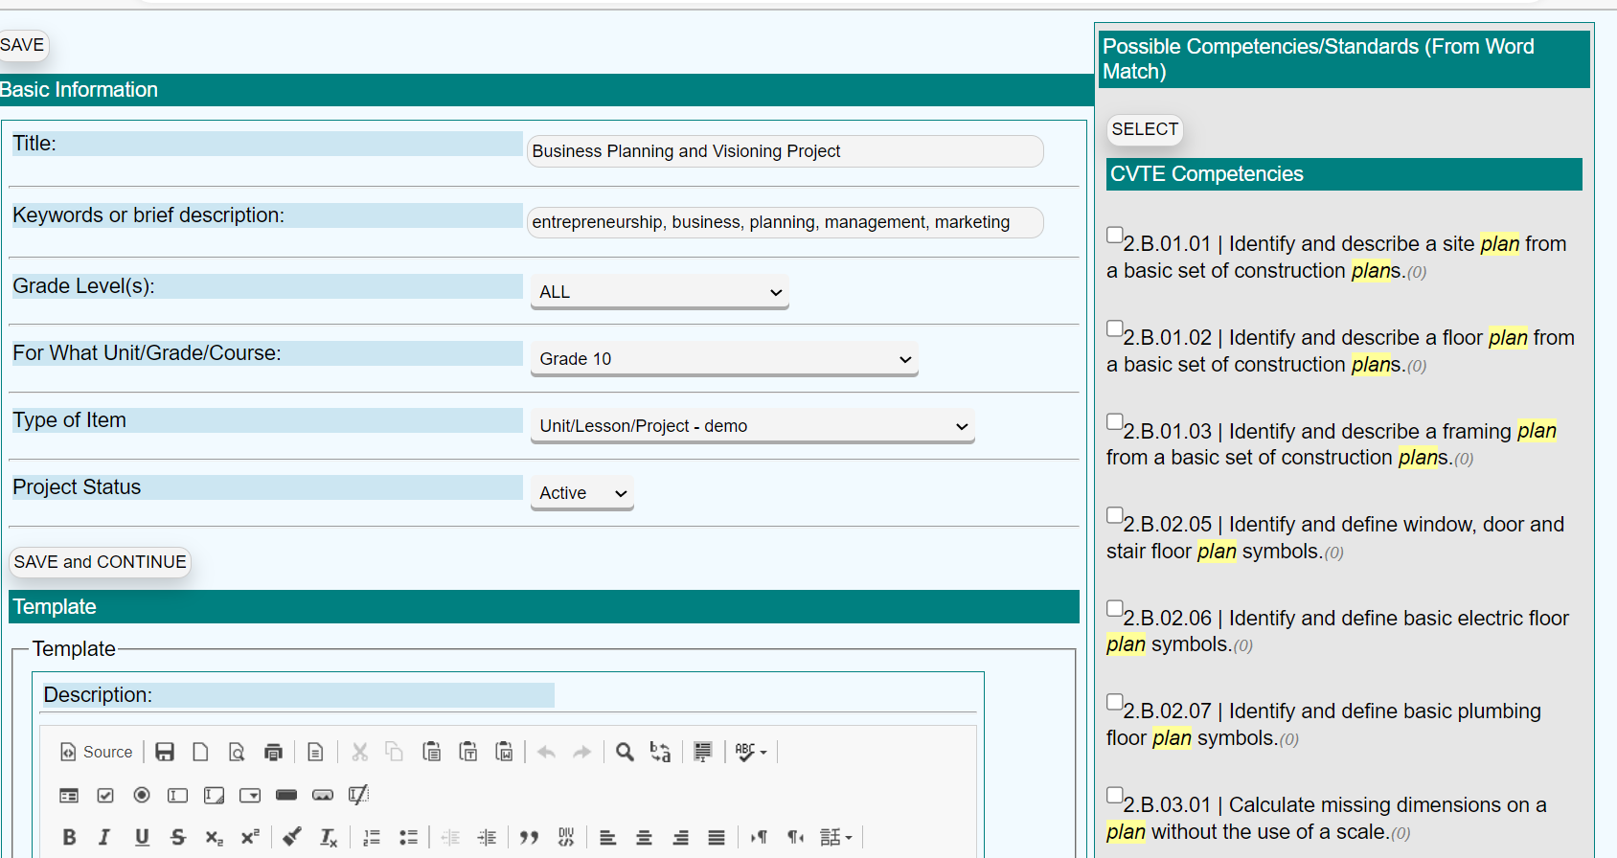
Lesson Planning Template
Use the Project/Unit Template to outline a lesson or unit, and search for and select related competencies.
Then use this customized list in the “custom grid” or in the student self-assessment view.

Slide 24
Project 6: Explore the Reports Menu.
[1.] On the navigation bar along the top of the screen, choose REPORTS MENU and then choose Reports Menu under that tab.
[2.] In the selection bar at the top of the page, choose ALL graduation years and click to APPLY.
[3.] Open Report H07: Average Ratings by Topic.
[4.] Print this report to a PDF.
[5.] Open Report I01: Industry-Recognized Credentials.
[6.] Print this report to a PDF.
→ Share the PDF of Report H07 or Report I01 as WORKSHOP PRODUCT #3

Slide 25
Project 7: Use the Custom Grid to rate selected competencies for your students
[1.] From the navigation bar along the top of the screen, choose Custom Grid.
[2.] When that screen opens, choose “Career Research Project” or “Acceptable Use Policy for School Network” or “Credential Plan” from the dropdown list, and choose your Grade 10 or 11 students and click to continue.
[3.] Notice that a custom grid will appear, with selected competencies relevant to that project.
[4.] In the selection bar at the top of the screen, copy and paste or type the codes for three or four competencies, such as 5.B.01.01, 5.C.01.01, 6.A.01.01 and click to continue.
[5.] Notice that a custom grid will appear, with those competencies.
[6.] Consider the question: When would it be useful for you to rate students based on a customized list of competencies such as these, rather than rating all competencies, topic-by-topic. Also consider: would it be useful to create a list of competencies for students to self-assess?

Slide 26
Project 8: Use the Projects/Units Template
[1.] From the navigation bar at the top of the screen, choose the “Lesson Planning and Frameworks Views” tab and choose “Projects/Units/Lessons Template.”
[2.] When this screen opens, click the button to create a new project.
[3.] Think of a project, lesson or unit that you teach every year, and fill in the name of that project, lesson or unit in the “Title” field. (Or fill in just “SAMPLE PROJECT”.
[4.] Fill in the following:
* Grade Levels: Choose Grade 09, 10, 11, 12 or ALL
* For what unit, grade or course: Fill in the grade level again, or type the name of a unit that the lesson belongs in.
* In Type of Item/Framework, Choose the first option, which is “Unit/Lesson/Project” for your program.
* Click to save and continue.
* You can skip the description for now.
[5.] In the section for “Competency Search Options” choose “Show All – Strand 2” and click to continue.
* Wait for the checklist of competencies to appear. In this checklist of competencies, check some of the relevant competencies and click to SELECT. Repeat, choosing “Show All – Strand 1” and select relevant competencies and click to SELECT.
[6.] Click to SAVE the project.
[7.] On the selection bar near the top of the screen, click to View/Print the project. Use Ctrl-P to open a print dialog box and save this screen as a PDF.
[8.] Then click to go to the Custom Grid to view the custom grid for this project.
→ Share the PDF of your project as WORKSHOP PRODUCT #4

Slide 27
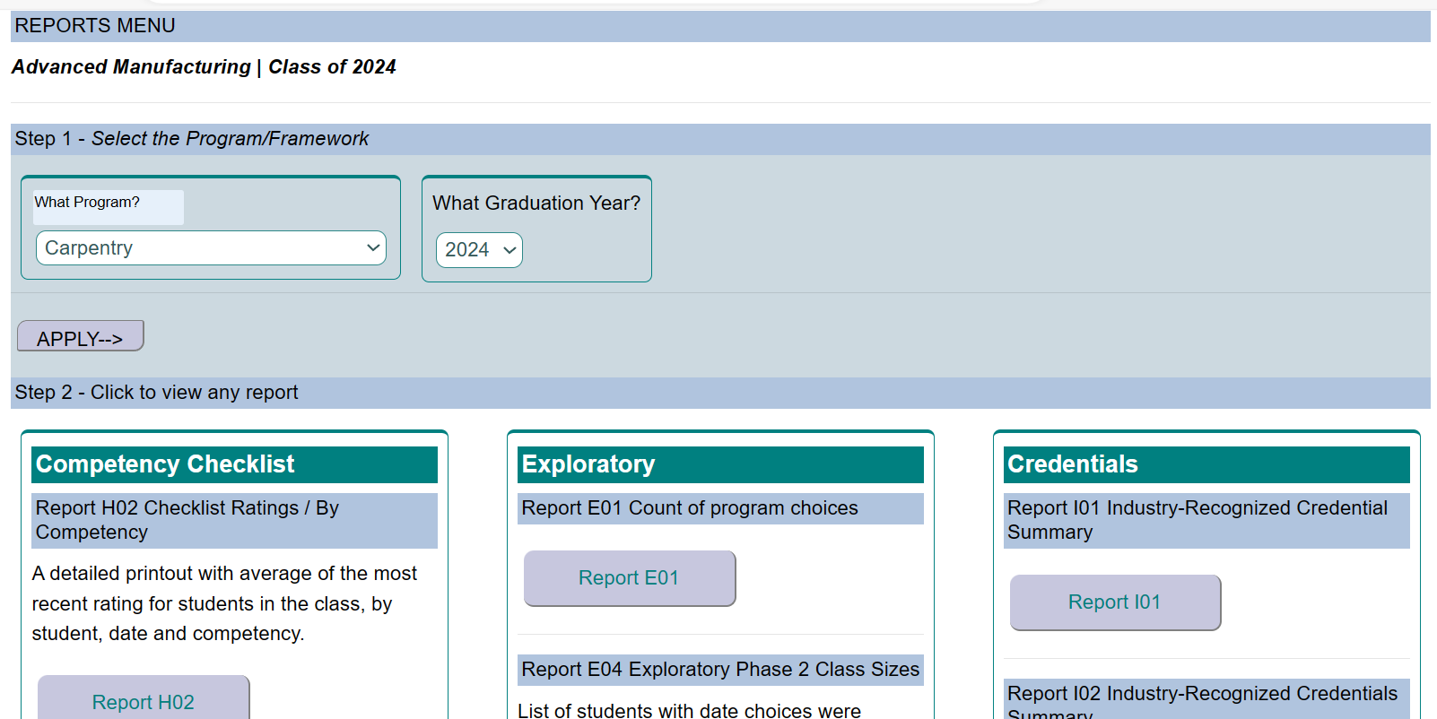
Reports Menu
Explore the Reports Menu to see a variety of summaries and lists.

