Slide 1
Using the Skills Library CVTE Checklist
Best Practices Presentation
November 2023

Slide 2
Agenda
Agenda
Best Practice #1: Develop a habit of using the Skills Library CVTE Competency Checklist regularly…. Set a routine…..
Best Practice #2: Share checklists with students and invite them to self-assess
Best Practice #3: Use the Skills Library Project Template or other tools to link projects, units, or lessons to the frameworks
Best Practice #4: Explore the Reports Menu… ask for additional reports… brainstorm new features…

Slide 3
Features to Explore
Grid Checklist …Evaluate students by Strand/Topic, for Strands 1-6 and for Strand C: Certifications … this is the basic checklist view.
Custom Grid … Evaluate students based on a custom list of competencies, based on the competencies relevant to a project or unit.
View / Print Checklist …. Share the checklist with students … print to a PDF or paper to share
Or invite students to use the Skills Library student pages … same address as the exploratory screens … to SELF-ASSESS using the frameworks.
Use the built-in Project Template to set up projects & units, along with the list of related competencies. Once you have saved projects and units in this template, you can use those competency lists in the CUSTOM GRID and students can use in the Self-Assess screen.

Slide 4
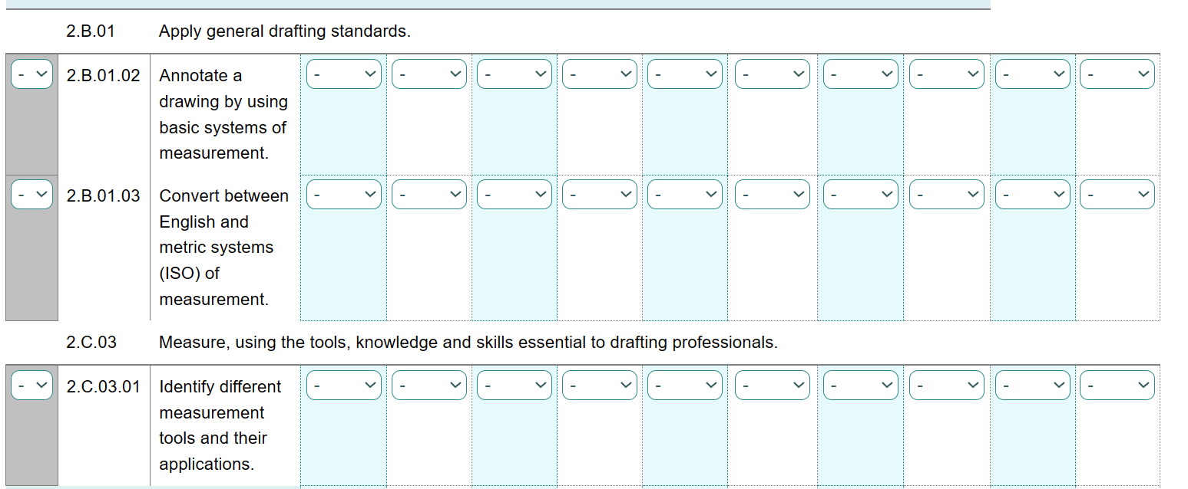
Best Practice #1: Develop a habit of using the Skills Library CVTE Competency Checklist regularly…. Set a routine…..
This is the basic GRID CHECKLIST, found under the “Competency Checklists” tab on the navigation bar.
At the top of the screen, select a strand/topic and student group and click to continue Use the “PRE-FILL” column on the left and the dropdowns to fill in competency ratings.
GRID CHECKLIST

Slide 5
Best Practice #1: Develop a habit of using the Skills Library CVTE Competency Checklist regularly…. Set a routine…..
Set a routine… update the checklist after completing a unit or project; or periodically during each marking period when you are working on assessments.
GRID CHECKLIST

Slide 6
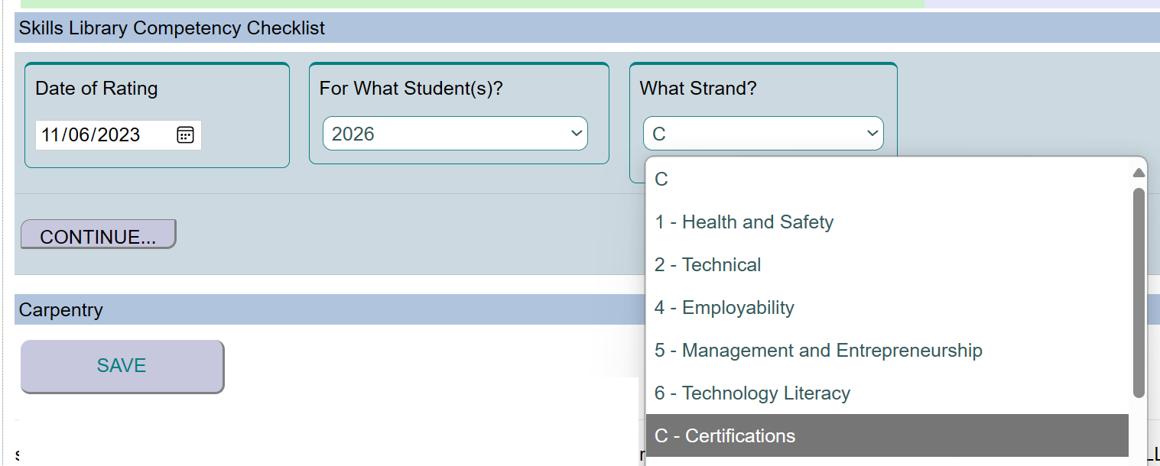
Best Practice #1: Develop a habit of using the Skills Library CVTE Competency Checklist regularly…. Set a routine…..
In addition to Strands 1-6, be sure to update “Strand C: Certifications” whenever students earn industry-recognized credentials.
GRID CHECKLIST

Slide 7
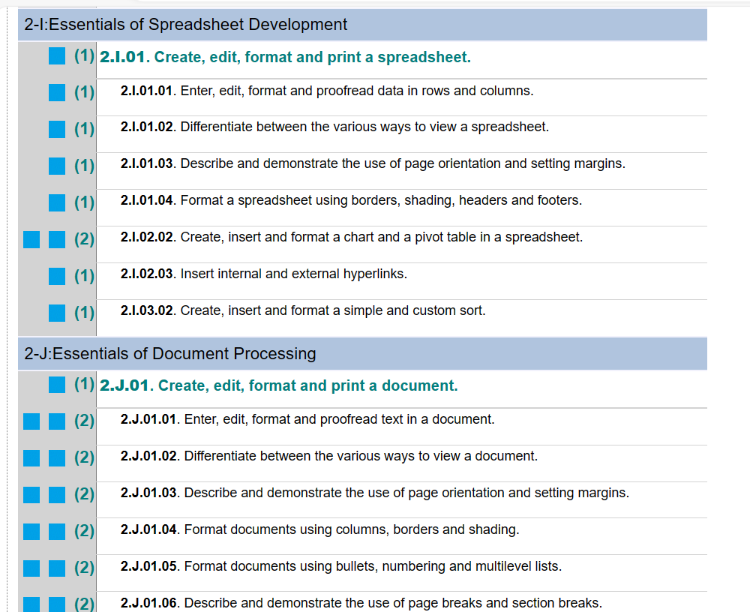
Best Practice #2: Share checklists with students and invite them to self-assess
Find the “Print/View” version of the checklist under “Competency Checklists” on the navigation bar in the main part of the database. You can print this to paper or PDF to share with students…
PRINT/VIEW CHECKLIST

Slide 8
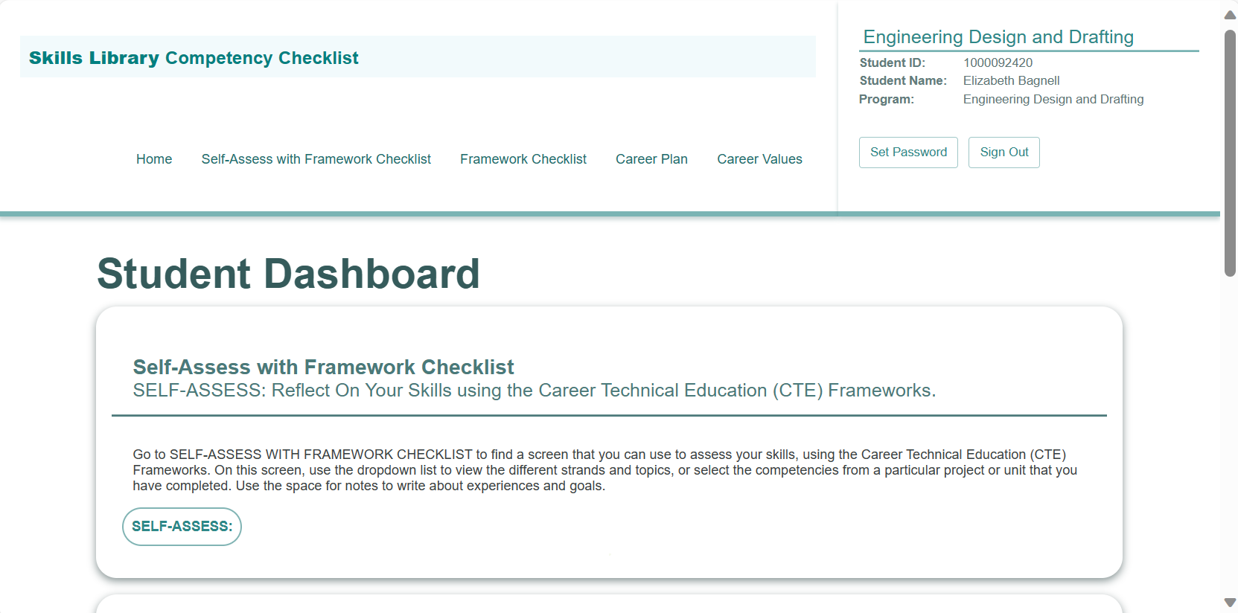
Best Practice #2: Share checklists with students and invite them to self-assess
…AND/OR you can also introduce your students to the Skills Library student pages.
Find the shortcut link and the full link on the database home page.
(The link is the same address as the Exploratory screens, and is available to students in any of your classes.)
SKILLS LIBRARY STUDENT PAGES

Slide 9
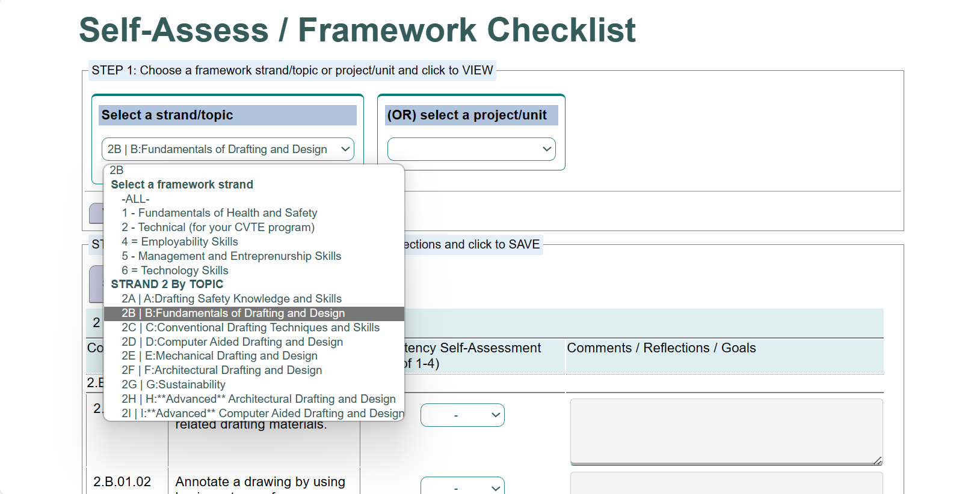
Best Practice #2: Share checklists with students and invite them to self-assess
Students can choose “SELF-ASSESS” and can use the screen to self-assess using the framework checklist.
You can direct them to choose a Strand/Topic….
STUDENT PAGES: SELF-ASSESS

Slide 10
Best Practice #2: Share checklists with students and invite them to self-assess
…. Or … if you use the project template to store projects/units, you can direct students to choose a Project or Unit from this dropdown list.
STUDENT PAGES: SELF-ASSESS

Slide 11
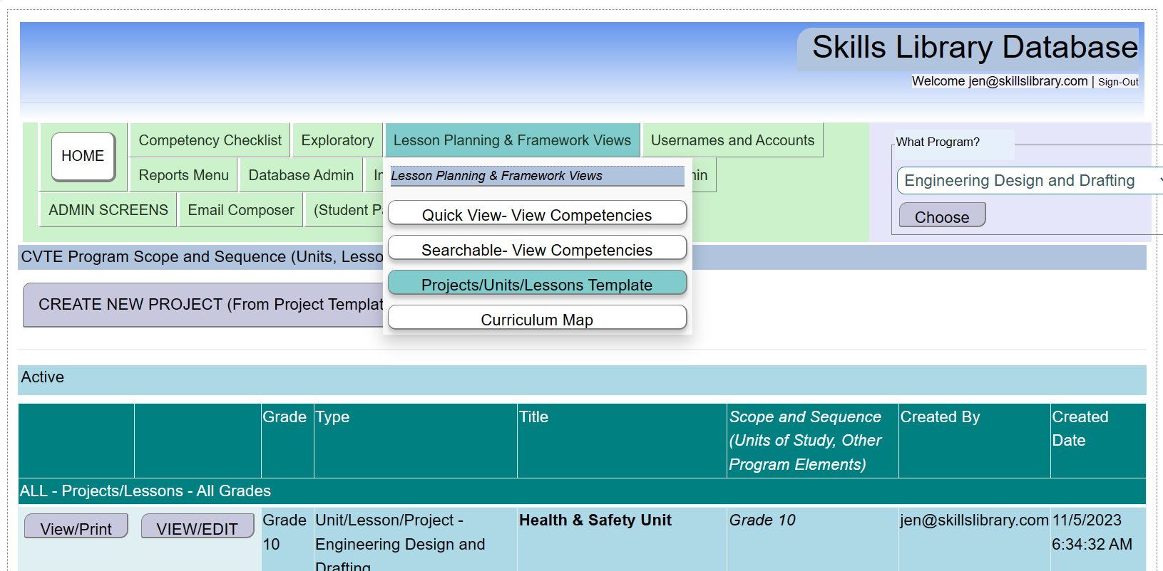
Best Practice #3: Use Skills Library Project Template to link projects, units, or lessons to the frameworks
Under “Lesson Planning and Framework Views” choose the link for the Projects/Units/Lessons Template.
Click the View/Edit an existing project or to create a new project.
PROJECT TEMPLATE

Slide 12
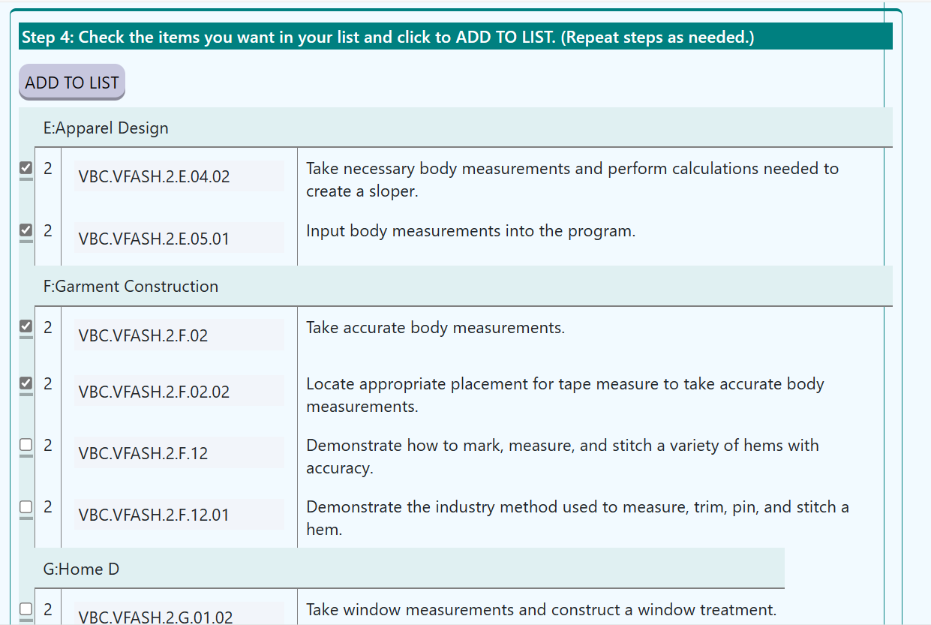
Best Practice #3: Use the Skills Library Project Template to link projects, units, or lessons to the frameworks
Fill in the template.
You can use the built-in tools to search and select skills/competencies, or just copy-and-paste from a list you created elsewhere. Save the project, and you will be able to reference this skill/competency list in the Custom Grid, and your students can reference it in the Self-Assessment screen.
PROJECT TEMPLATE

Slide 13
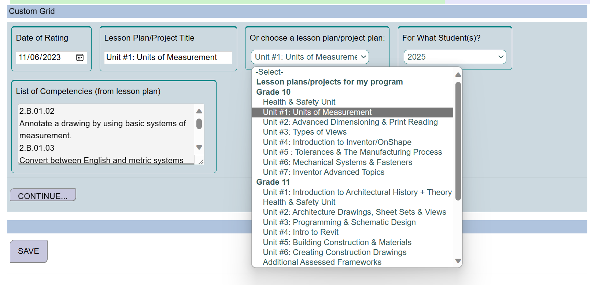
Best Practice #3: Use Skills Library Project Template to link projects, units, or lessons to the frameworks
Find the “Custom Grid” under the “Competency Checklists” tab.
You can choose any of your projects, or any school-wide shared projects… and display a custom grid with the relevant competencies. Use this grid to fill in ratings for your students.
CUSTOM GRID

Slide 14
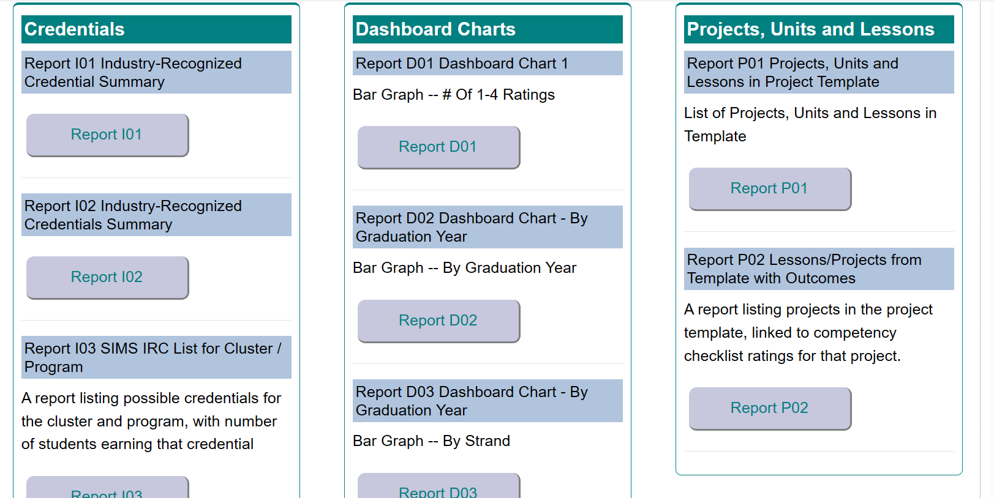
Best Practice #4: Explore the Reports Menu… ask for additional reports… brainstorm new features…
Visit the Reports menu to view some of the reports… and feel free to ask for any reports you would like to see.
REPORTS MENU

Slide 15
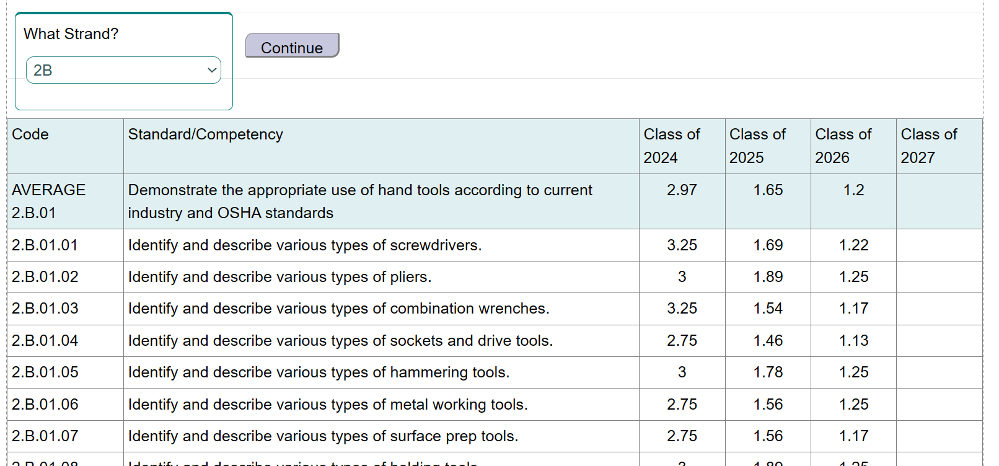
Best Practice #4: Explore the Reports Menu… ask for additional reports… brainstorm new features…
REPORTS MENU

